Slide 1
Student Task Manager
Group project demo 2
Team members:
Safal Shrestha: Team leader, backend, database, full-stack integration
S Q Abdullah Al Mamun: Frontend design, UI support

Slide 2
Project Problem
Students have many assignments, deadlines, and courses to manage.
It is easy to forget tasks or lose track of progress.
Many students need a simple system to organize academic work in one place.

Slide 3
Project Objective
The goal is to build a web-based task manager for students.
It helps users create, update, track, and complete coursework tasks.
Each user has a private account and their own task list.

Slide 4
Main Features
Main Features
User registration and login
Private tasks for each user
Add, view, edit, update, and delete tasks
Task status: pending, in progress, completed
Course name, description, due date, and priority
Search and filters
Dashboard summary cards
Circular progress chart

Slide 5
System Design
Frontend
HTML, CSS, JavaScript
Backend
Python HTTP server
Database
SQLite
Simple explanation
“The frontend sends requests to the Python backend. The backend checks the signed-in user, processes the request, and stores or retrieves data from SQLite.”

Slide 6

Database Design
Users
Stores user account information.
Sessions
Stores login session information so the system knows who is signed in.
Tasks
Stores all task information for each student.
Important Task Fields
title, course, description, due_date, priority, status, user_id

Slide 7
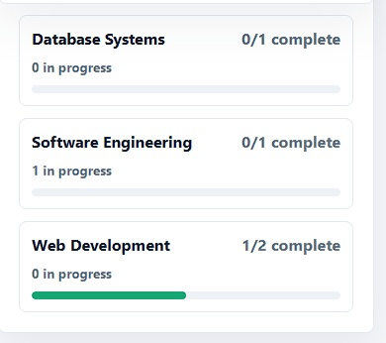
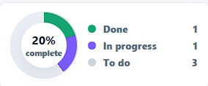
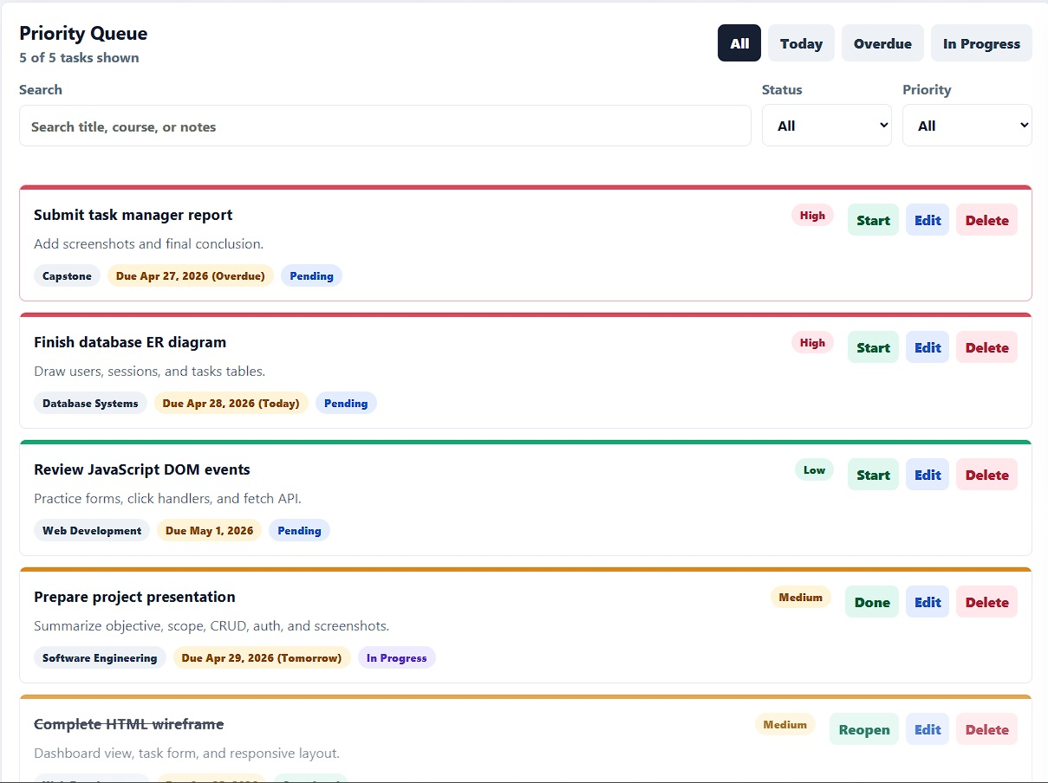
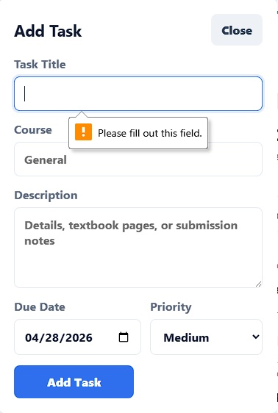
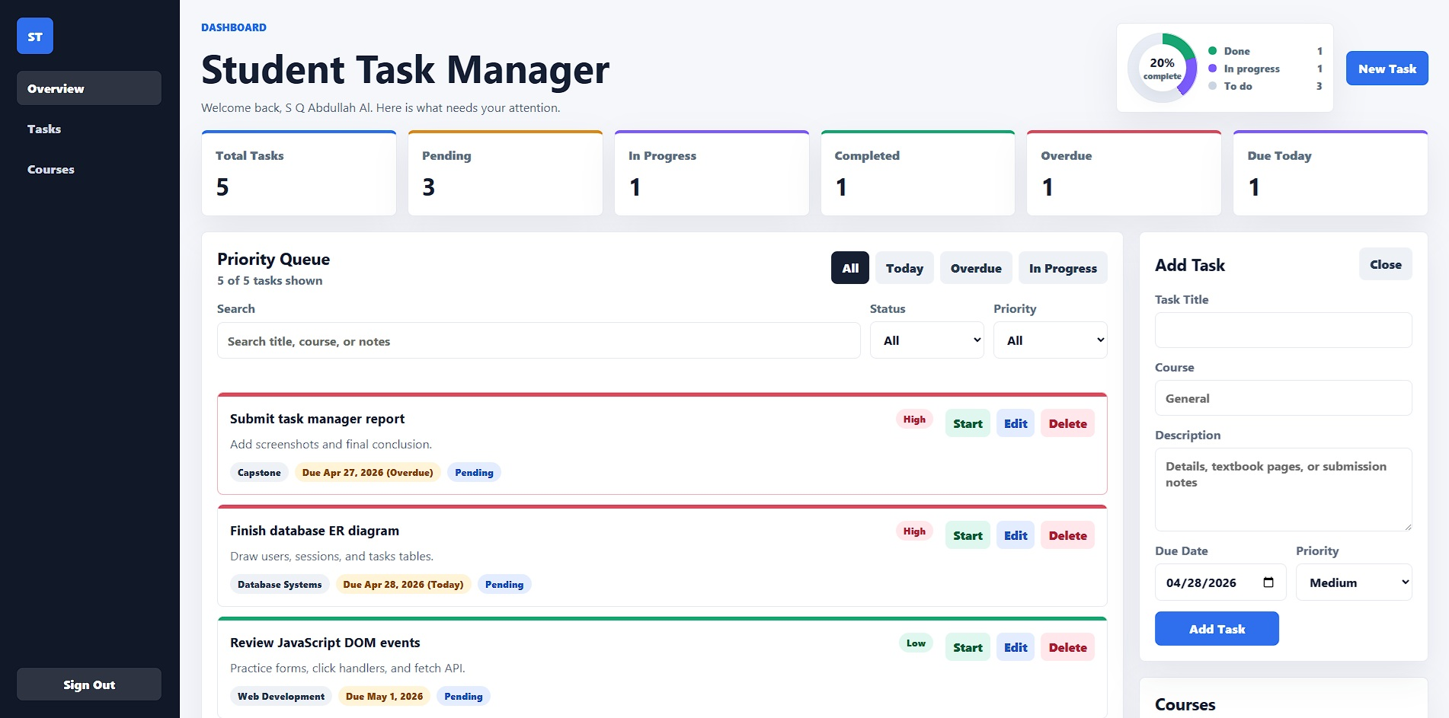
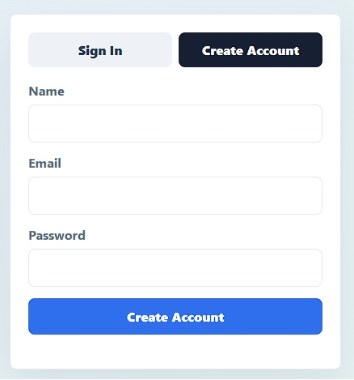
UI / Demo Screenshots

Slide 8
Team Contributions
Safal Shrestha
Full-stack development
Backend API
Authentication
Database integration
Testing
S Q Abdullah Al Mamun
Frontend layout
Visual design support
UI testing
Documentation support

Slide 9
Challenges and Future Improvements
Challenges
Adding login without external frameworks
Making every user’s data private
Connecting frontend actions to the backend API
Handling task status and progress chart
Future Improvements
Calendar view
Reminder notifications
Drag-and-drop task board
File attachments
More analytics

Slide 10
Conclusion
The Student Task Manager helps students organize academic work.
It supports:
User accounts
Private task lists
Full CRUD operations
Task status tracking
Course organization
Visual progress reporting

